Slide 1
HERITAGE/HISTORIC BUILDINGS ST.KITTS-NEVIS
LAVERNE M BROOKES 2017

Slide 2
What makes a building Historic/Heritage?
Integrity
Have there been changes made to the building?
Has the building always fulfilled its present function?

Slide 3
What makes a building Historic/Heritage?
History
Who were the original occupants and what did they do for a living?
Did an event of historical importance occur in the building?
Can the building be said to illustrate a historical issue?

Slide 4
What makes a building Historic/Heritage?
Environment
Does the building look like any others in the community?
Is the building a landmark ?

Slide 5
What makes a building Historic/Heritage?
Architecture
When was the building constructed?
Who designed and/or constructed the building?
Did the designer use a style or tradition to create the design?
What materials were used in the construction of the building?

Slide 6
HISTORIC/HERITAGE BUILDINGS ST.KITTS-NEVIS
St. Georges Anglican Church
Co-cathedral of Immaculate Conception
St. Thomas Anglican ( Middle Island ) Anglican Church
Cottle Church
St. Pauls Anglican Church
St. Thomas Lowland Anglican Church

Slide 7
HISTORIC/HERITAGE BUILDINGS IN ST.KITTS-NEVIS
Bath Hotel and Spring House
Museum of Nevis History
Ottley’s Plantation Inn
The Government House
National Museum
Fairview / Nirvana Guest House

Slide 8
HISTORIC/HERITAGE BUILDINGS ST.KITTS-NEVIS
The Georgian House
Rawlins’ Plantation House
Nisbet Plantation Beach Club Hotel

Slide 9
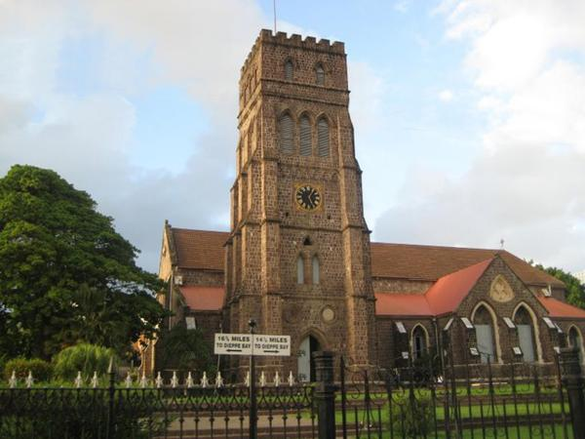
St . Georges Anglican Church
History
French occupation of Basseterre, a Roman Catholic Church, named Notre Dame, was erected by the Jesuits. Notre Dame was burnt to the ground in 1706 during the Anglo-French War by English soldiers who were billeted there.
Re-built by 1710 and re-named St. George’s.
From the 1720’s, it became a place of worship for the Anglicans. It Damaged again in the fire of 1763, but once again restored.
The earthquake of 1842, followed by the hurricane of 1843, reduced it to ruins, and an entirely new building was planned. But the congregation continued to worship in the ruins until a new church was consecrated on the 25th March, 1859. Seven years afterwards, it was gutted in the Great Fire of 1867; and was re-roofed, and restored in 1869. In a series of hurricanes since 1989, the church was again damaged but restoration work has since been undertaken on the building
Location : Basseterre , St. Kitts
Famous: Home of two Christian Religion ( Catholicism and Anglicanism) . Face the Street of Parliamentary and Ministries, Church Street.

Slide 10
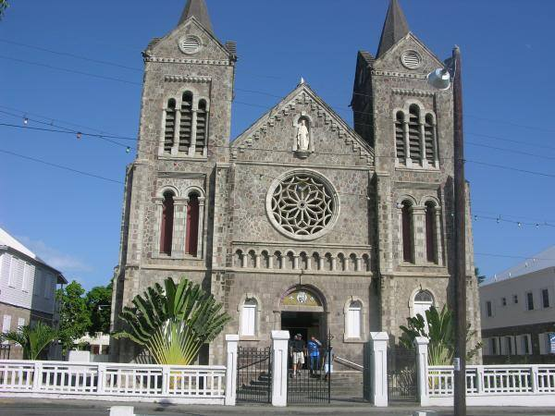
Co-cathedral of Immaculate Conception
History
St. Kitts was taken over by the English in 1713, and as such Roman Catholics were forbidden by law to worship in public. However, in 1829 the revival of Roman Catholicism. Portuguese migrants from the island of Madeira from 1835 onwards strengthened the growth of the Roman Catholic community.
Built : in or about 1856; it was called the Church of the Immaculate Conception. In 1927, it was demolished and replaced by a modern edifice on the same site on East Square Street
Famous : Major tourist attraction , stained glassed windows and gothic architecture.

Slide 11
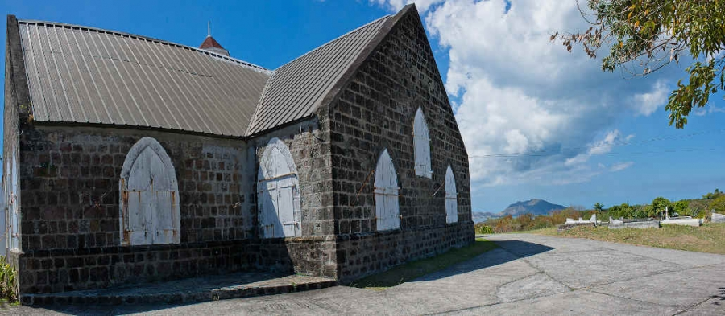
St. Thomas’ Lowland Anglican Church
History
The first Anglican Church in the Caribbean, and the oldest church on Nevis.
Built: 1643
Location: It is located on the main road about three miles north of Charlestown, and was built to serve the town of Jamestown, the island's original capital that disappeared. The church is perched high on a hill overlooking St. Kitts
Famous : Tombstones bearing names of Nevis' early settlers. They date back to1649 and there is a vault that holds the remains of John Huggins (1763-1821), the founder of Bath Hotel

Slide 12
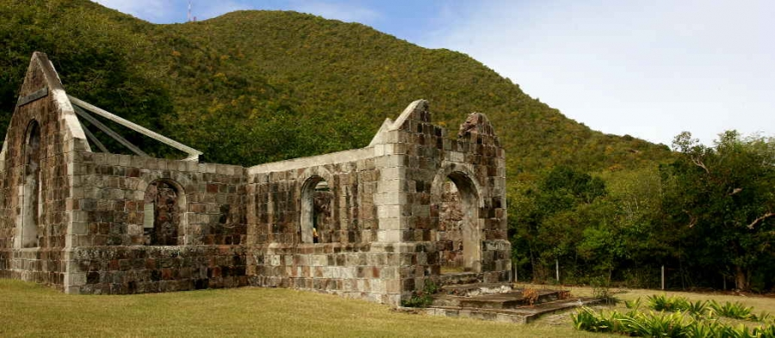
Cottle Church
History
John Cottle, once the president of Nevis and a planter, built this tiny church as a place for his family and his slaves to worship together. Cottle Church is part of the 980-acre Round Hill Estate. The structure was severely damaged in a 1974 earthquake and again in 1989 during Hurricane Hugo. The stone building still provides a glimpse into our history.
Built : 1824
Location: North of Charlestown, hidden in the woods off the main road, just south of the Vance Amory International Airport. A small sign on the main road marks the beginning of a dirt track that leads back to the church.
Famous :A very lenient slave owner, Cottle created this Anglican Church, which was never consecrated, since it was illegal at the time for slaves to worship. Cottle Church is still a primary tourist attraction and stunning wedding location.

Slide 13
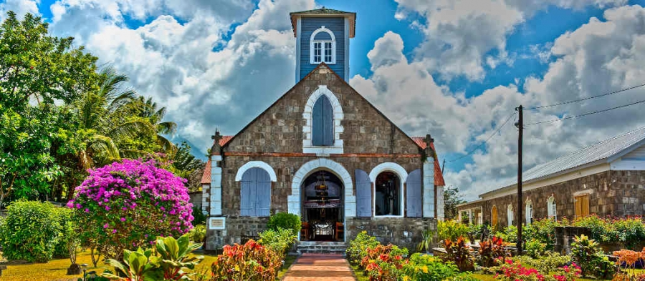
St. Pauls’ Anglican Church
History
This parish church was built about 1830 in a typical cruciform plan with gabled roof.
The stained glass windows beside the altar are in memory of Rev. Daniel Gatward Davies, priest from 1812-1825, who converted slaves before the emancipation. He went on to become the Bishop of Antigua.
Famous: The yard of the church contain graves dating to 1669.

Slide 14
St. Thomas’ Anglican Church
History
ST. THOMAS’ CHURCH – MIDDLE ISLAND is the oldest Anglican Church in the West Indies, introduced shortly after the arrival on the island of St Kitts of the eponymous Captain Thomas Warner. Reverend John Teatley (also spelt ‘Featley’). Former member of Magdalene College and Fellow of All Souls, Oxford, he became Rector of Middle Island from 1625-1634, establishing the first Anglican congregation on the island after he arrived with Sir Thomas Warner.
The church was destroyed in 1841 by hurricane and earth quake. Later rebuilt in 1860 and consecrated in 1861.
Famous :
The tombs of Sir Thomas Warner and Samuel Jefferson situated inside the church

Slide 15
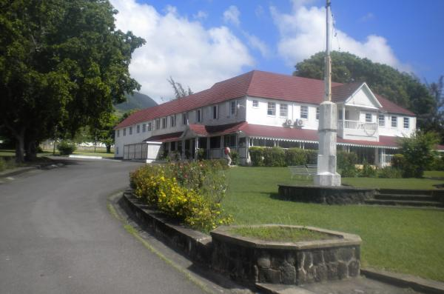
The Government House
History
The Blake family built this property around the time of Emancipation (1834) and soon after sold it to Thomas Harper, a planter-merchant and Vestryman. Harper named the property Springfield.
Archdeaconry of St Kitts was created the rector of St. George was accommodated . Later, the venerable Francis Robert Brathwaite, the first Archdeacon, bought Springfield from the Harpers around 1848.
Location: Basseterre, St. Kitts
Famous : Home of the Governor General of The Federation of St. Kitts and Nevis.

Slide 16
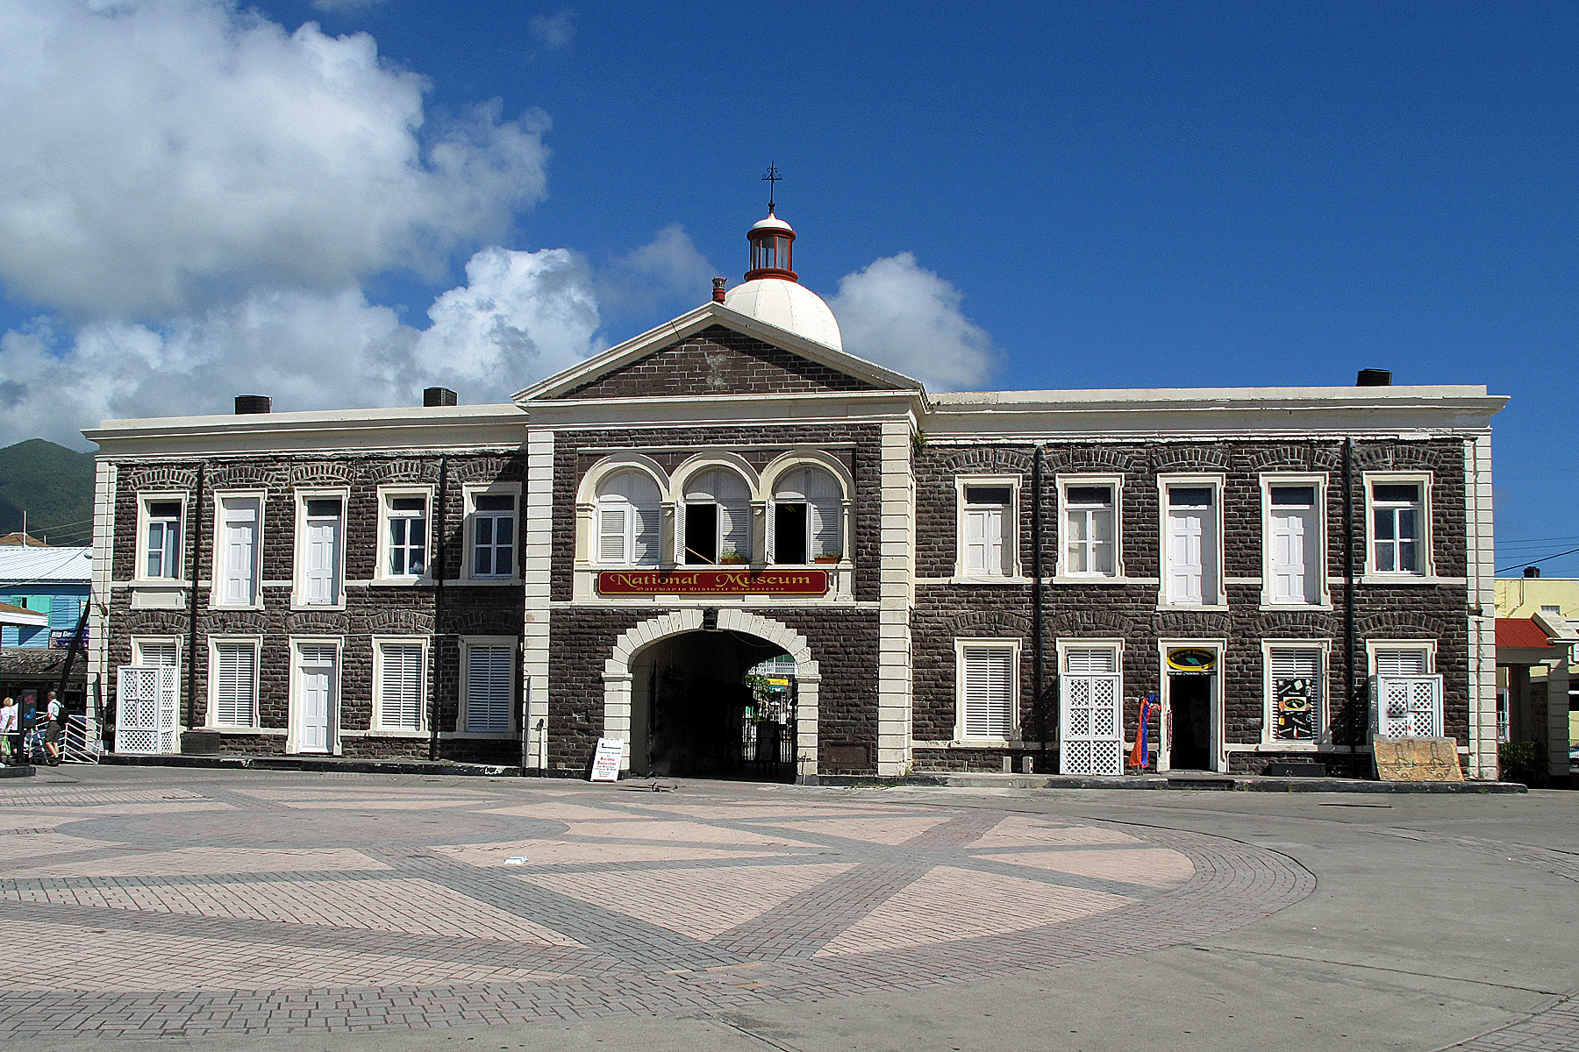
National Museum/Old Treasury Building
History
Lady Haynes-Smith laid the foundation stone for the Treasury Building in 1894. The building, “a two-story stone structure … is stylistically Georgian Architecture, adapted to the Caribbean, and axially related to Fort Street and the former Treasury Pier, which was the historic gateway to the island by way of the central arch.” (St. Christopher Heritage Society, 2000 p.2). After Emancipation and Apprenticeship in 1838, importing indentured labour from Madeira, Portugal temporarily solved the island’s labour shortage problems. Planters at that time had to deposit in the Treasury an amount to cover the cost of a return fare for each labourer they imported. Many Portuguese did not return to their homeland after their indentureship was up. In the 1890’s, when it was obvious that there was a need for a new Treasury, the planters donated the unused passage monies to government for its construction.
Built : 1890s
Location: Basseterre, St. Kitts
Famous : Gateway to St. Kitts, Former treasury, National Museum, St. Christopher Heritage Trust.

Slide 17
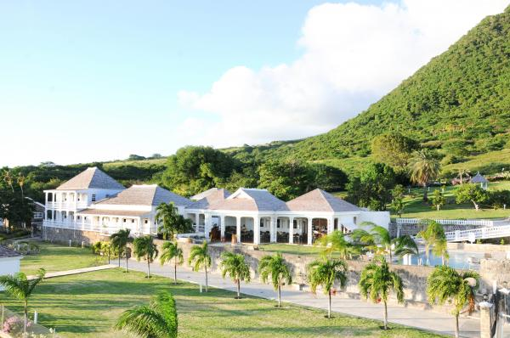
Fairview / Nirvana Great House
History
Three hundred year old property. Fairview Great House provides a true representation of a colonial St. Kitts Great House. The Great House displays a historical information room where you can learn more about previous owners of the property, life on the island in colonial times, and the process undertaken to fully restore this historic gem.
Built : 1701
Location: Boyd’s Village, St. Kitts
Famous :The meticulously landscaped tropical botanical garden feature settings and plants of the 1700s - 1920s with a wide variety of fruit trees, palms, shrubs, and flowering plants.

Slide 18
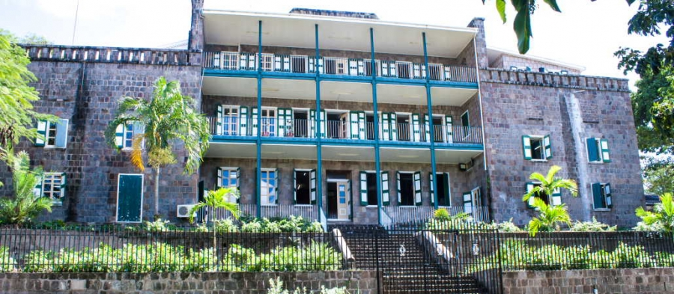
Bath Hotel and Spring House
History
Guests would come by ship from throughout the West Indies and Europe for this pleasurable experience.
John Huggins, a merchant and aristocrat built the large, stone hotel at a cost of 43,000 "island" pounds, and surrounded it with lush landscaping, statuary, and goldfish ponds. The hotel was 200 feet long and 60 feet wide. Within the compound of the Bath Hotel is the Spring House, a two story masonry structure which was constructed from local hand cut stones. This building sits on the bank of the Bath Stream. The facility comprises of five thermal baths whose source of water springs from the base of the house. The spring water is reputed to contain minerals of medicinal value and is known to have cured chronic rheumatism and gout. Since then the hotel has had various uses, reopening as a hotel from 1912 until 1940. It was used as training centre for the West Indian regiment during World War II, and most recently, the temporary headquarters of the Nevis police while the new station was built.
Built : 1778
Location : Charlestown , Nevis
Famous: The Bath Hotel was once a playground for the rich and famous who came to Nevis to take in the therapeutic, hot spring baths. Dignitaries such as Lord Nelson, Samuel Taylor Coleridge, and Prince William Henry, who was the Duke of Clarence, visited the hotel in its heyday. Most Government Offices were located in the building.

Slide 19
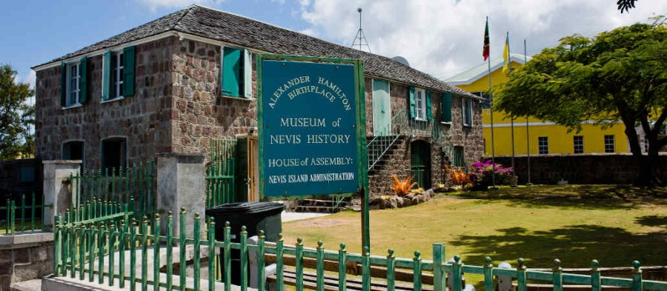
Museum of Nevis History/ Alexander Hamilton Birth Place
History
This two-story Georgian style building. The building today, known as Hamilton House, houses one of the island's two museums on the first floor. The second floor is the meeting room for the Nevis House of Assembly.
Built : 1680, but was destroyed in an earthquake in 1840, and was restored in 1983. Its historic value coupled with its beautiful setting on Charlestown harbour make it an island treasure and a delightful place to spend an afternoon.
Location: Charlestown , Nevis
Famous : Birthplace of Alexander Hamilton in 1757. Hamilton lived on the island until the age of nine
Later in his life he helped draft the U.S. Constitution and was the first secretary of the Treasury. He was an outspoken advocate of the emancipation of slavery

Slide 20
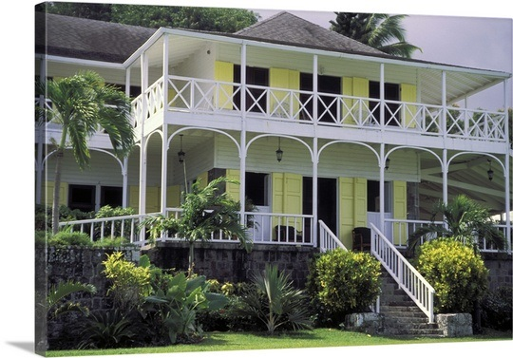
Ottley’s Plantation Inn
History
Originally a 17th century sugar plantation, Ottley’s Plantation Inn is situated on 35 acres of rolling lawns and gardens at the foot of majestic Mt. Liamuiga. It is a magnificent Caribbean hideaway with breath-taking views of the Atlantic.
Built: 16th Century
Location: Ottley’s Village , St. Kitts
Famous
The swimming pool is built into the remains of the old boiling house.

Slide 21
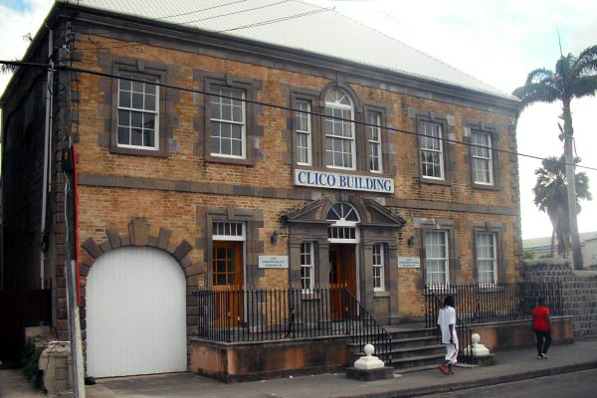
The Georgian House
History
By 1836 it was owned by James Berridge. He was a leading merchant who owned several vessels that traded amongst the islands, as far as Halifax and Bermuda, and in times of peace, even with America. Berridge came to St. Kitts in 1794 at the age of 20 “with no resources but his own abilities”. By 1812 he was not only a thriving merchant, but also Treasurer of the Island, Lieutenant Colonel of the Windward Regiment of Foot and Aide de Camp to the Governor. In the early 20th century, the house was home to the prominent businessman Burchell Marshall and his family. It was later used by the St. Christopher Club, often referred to as the Gentlemen’s Club.
Location: South of Independence Square, Basseterre. St. Kitts
Built: after 1790
Famous
Like other buildings surrounding the Square, is thought to have at one time stored slaves in its cellars prior to their transfer to the plantations

Slide 22
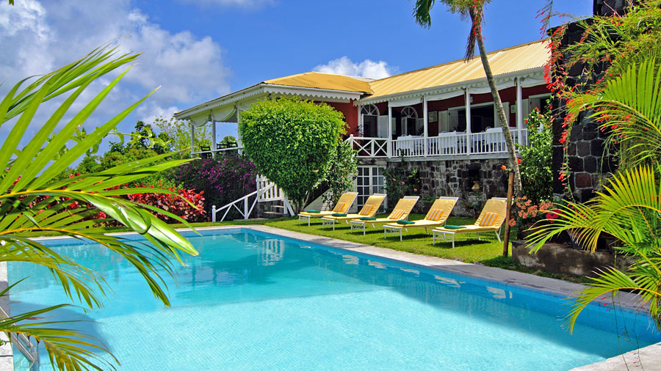
Rawlins' Plantation House
History
Rawlins Plantation is a tranquil, 10-room country Inn built from the ruins of a sugar cane plantation.
Built: 17th Century
Location: St. Pauls , St. Kitts
Famous : Peaceful , tranquil, secluded setting away from the hustle and bustle and caring staff.

Slide 23
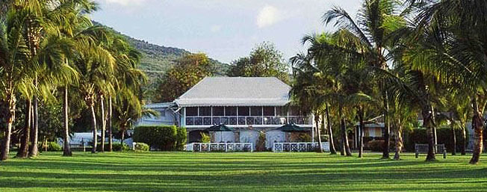
Nisbet Plantation Beach Club Hotel ( Great House)
History
Nisbet Plantation Beach Club is the Caribbean's only historic plantation Inn on the beach.
Build by: William Woodward and Mary Herbert. Franny Nisbet (Frances Herbert) married Dr. Jonah Nisbet. Dr, Nisbet died
Year : 1778
Location : New Castle, Nevis
Famous for: Vice Admiral Horatio Lord Nelson marriage to Fanny Nisbet owner
Nisbet Plantation is one of the world's best resorts according to

Slide 24
References
http://www.qholidays.co.uk/destination_hotel.asp?dID=2&hID=404
http://www.telegraph.co.uk/travel/destinations/caribbean/saint-kitts-and-nevis/st-kitts/hotels/ottleys-plantation-inn-hotel/
http://heritagebrandon.ca/heritage-designation/historical-significance
http://www.stkittstourism.kn/
https://www.google.com/search?q=national+Museum+st.kitts&tbm=isch&tbo=u&source=univ&sa=X&ved=0ahUKEwiItK6o-5PUAhUDJCYKHQyFDZ4QsAQIRQ&biw=1138&bih=530&dpr=1.2#imgrc=4Ub2IIDP0NJGeM
http://www.stkittstourism.kn/explore-st-kitts-activities-attractions-historical-sites-display.php?business=138

Slide 25
Resources
http://www.stkittsheritage.com/?page_id=1183

